Slide 2
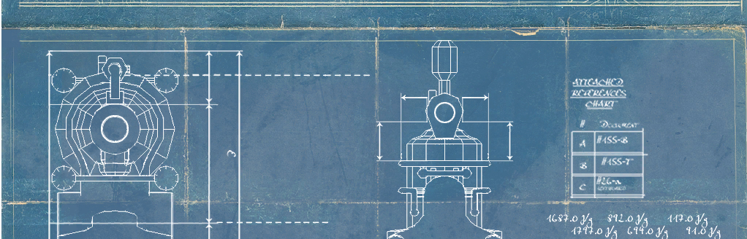
ROBOVAC
COA LAB PROJECT (2016-17)
Himesh jain (15UCS172)
Riya Bagaria (15UCS109)
- LNMIIT, JAIPUR
SHANTANU GAUTAM (15UCS123)
YASH NAG (15UCS173)

Slide 3
INTRODUCTION
The ROBOVAC project will include a basic simulation of functionalities of a robotic vacuum cleaner. The project will include basic functionalities of robotic vacuum cleaner like automated cleaning with some specific features.
It will be a mini model of a full fledged and with many possibilities to grow in future, automated cleaning technology.

Slide 4
Functions
Scheduling
Mapping
Navigation
Visual Localization
Dust Detection
Surface Boost
Virtual Guard
Self Maintenance
Charging
App Updates

Slide 5
Memory model
The memory model will be Byte Addressable, with Cell Size: 16 Bits
We will further be using Little Endian, Aligned Memory Instruction.
16-bit system that fetches bytes sequentially from memory. If it fetches the least significant byte first, it can start doing the addition while the most significant byte is being fetched from memory. This parallelism is why performance is better in little endian and the reason why we chose it.

Slide 6
registers
We will be using 16 general purpose registers.
R0-R15, will hold key local variables and intermediate results of calculations.
R0-0000
R1-0001
....
R15-1111
Special Registers
Program Counter
Stack Pointer
Instruction Register
Input Handler Register
Output Handler Register
Flag Register

Slide 7
Instruction Format
0 address instruction:
1 address instruction:
2 address instruction:
`
Opcode
opcode | Address1
opcode | Address1 | Address2
Scheduling – 2 Address Instruction
Mapping – 3 Address Instruction
Navigation – 2 Address Instruction
Visual Localization – 2 Address Instruction
Dust Detection – 2 Address Instruction
Surface Boost – 2 Address Instruction
Virtual Guard – 2 Address Instruction
Self Maintenance – 0 Address Instruction
Charging – 1 Address Instruction
App Updates – 1 Address Instruction
Notes:
Scheduling – SCH R1(current time) R2(required time).
Mapping –
Navigation –

Slide 8
INSTRUCTION DESIGN
TASK | OPCODE | BINARY CODE
Halt | HLT | 1111111111110000
Retreat Motion | RTM | 1111111111110001
Move Up | MOVU | 1111111111110010
Move Right | MOVR | 1111111111110011
Get Current Coordinate | GCC | 1111111111110100
Move Down | MOVD | 1111111111110101
Send Log | SLG | 1111111111110110
Self Charge | SFC | 1111111111110111

Slide 9
INSTRUCTION DESIGN
TASK | OPCODE | BINARY CODE | ADDRESSING TYPE
Jump | JMP | 111111110000 | Label
Jump If Less than Equal to | JLE | 111111110001 | Label
Jump If Greater than | JIG | 111111110010 | Label
Charging Level | CGL | 111111110011 | Register
Diameter Detection | DIMD | 111111110100 | Register
Get Density | GETD | 111111110101 | Register
Jump If Greater than Equal to | JGE | 111111110110 | Register
Obstacle detection | ODET | 111111111010 | Register
Get Cleaned Tiles | CLT | 111111111011 | Register
Get Total Tiles | TOT | 111111111100 | Register
Get Scheduled Time | GST | 111111111101 | Register
Count for time | TIMER | 111111111110 | Register

Slide 10
INSTRUCTION DESIGN
TASK | OPCODE | BINARY CODE | ADDRESSING TYPE
Compare | CMP | 11110000 | Register Value
Divide | DIV | 11110001 | Register Reg
Move | MOV | 11110010 | Register Value
Subtract | SUB | 11110011 | Register Reg
Add | ADD | 11110100 | Register Register
Multiply | MUL | 11110101 | Register Register
Clean | CLN | 11110110 | Value Value
Current Time | TYM | 11110111 | Register Value(0)
Suction Power | SUP | 11111000 | Register Value
Set Power | SETP | 11111001 | Register Value

Slide 11
INSTRUCTION DESIGN
Data Transfer
MOV-Move data to register; move register to register.
Program Flow Control
HLT- Stops the Program.
JMP – Jump to a Specific Address.
Label – For reference to a particular

Slide 12
INSTRUCTION TYPES …
Machine Specific Instructions
GST – Returns Scheduled time.
GCC – Returns Current coordinate of ROBOVAC.
TIMER – Counter for time.
SUP – Adjustment of intensity of suction.
DIMD – Detects the Diameter of Dust particles via sensor
SETP - Set Power.
SFC – Cleans itself.
GETD – Returns the Density of the surface.
ODET – Detects obstacle in the path.
CLT – Returns No of Cleaned Tiles,
TOT - Returns Total no of Tiles,
CGL – Displays battery level.
SLG - Notification from Apps and output from logs.
RTM – Retreats its Motion
MOVU, MOVR, MOVD – Move the ROBOVAC in a specific direction.

Slide 13
Data TYPEs
Numeric data types.
– Integer types: 8 bits (counting and identification).
– Floating-point types: 16 bits (measuring).
Nonnumeric data types.
– Characters: ASCII (7 bits)
– Boolean values: bytes 0 and 1.
– Pointers: machine address.

Slide 14
Addressing mode
Immediate
Register
Direct
Stack Based

Slide 15
Flow of control handling
Input Handler
Output Handler
Error Handler

